Slide 1
Oncology Extension SQL

Slide 2
Scope
Changes to CDM introduced by oncology extension
Table | Change | Enabled Functionality
MEASUREMENT | Two additional columns | Diagnostic modifiers
EPISODE_EVENT | New table | Episode to event relationships
EPISODE | New table | Episode to episode relationships
Goal: Use SQL queries to leverage the oncology extension beyond what is currently supported by ATLAS

Slide 3
Scope
Changes to CDM introduced by oncology extension
Table | Change | Enabled Functionality
MEASUREMENT | Two additional columns | Diagnostic modifiers
EPISODE_EVENT | New table | Episode to event relationships
EPISODE | New table | Episode to episode relationships
Goal: Use SQL queries to leverage the oncology extension beyond what is currently supported by ATLAS
Our focus

Slide 4
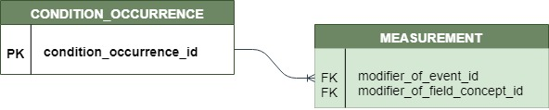
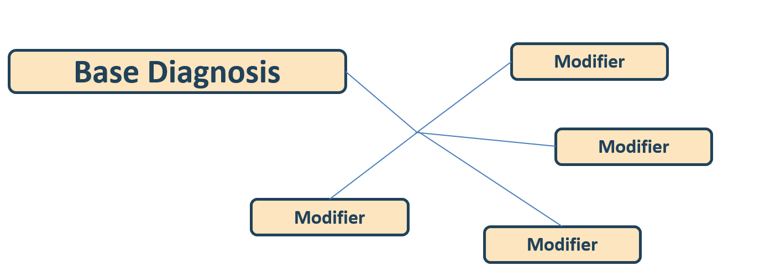
Modifiers
Notes:
F

Slide 5
Modifiers
“What is the primary key of the table being modified?”

Slide 6
Modifiers
“What is the primary key of the table being modified?”
CONCEPT
concept_id | concept_name | domain_id | vocabulary_id | concept_class_id
1147082 | procedure_occurrence.procedure_occurrence_id | Metadata | CDM | Field
1147094 | drug_exposure.drug_exposure_id | Metadata | CDM | Field
1147115 | device_exposure.device_exposure_id | Metadata | CDM | Field
1147127 | condition_occurrence.condition_occurrence_id | Metadata | CDM | Field
There is a concept for each field in CDM
modifier_of_field_concept_id :
References primary key of related table
Notes:
Vocabulary_id = CDM, concept_class_id = Field

Slide 7
Modifiers
“What is the primary key of the table being modified?”
CONCEPT
concept_id | concept_name | domain_id | vocabulary_id | concept_class_id
1147082 | procedure_occurrence.procedure_occurrence_id | Metadata | CDM | Field
1147094 | drug_exposure.drug_exposure_id | Metadata | CDM | Field
1147115 | device_exposure.device_exposure_id | Metadata | CDM | Field
1147127 | condition_occurrence.condition_occurrence_id | Metadata | CDM | Field
There is a concept for each field in CDM
modifier_of_field_concept_id :
References primary key of related table
Is a foreign key to CONCEPT
Notes:
Vocabulary_id = CDM, concept_class_id = Field

Slide 8
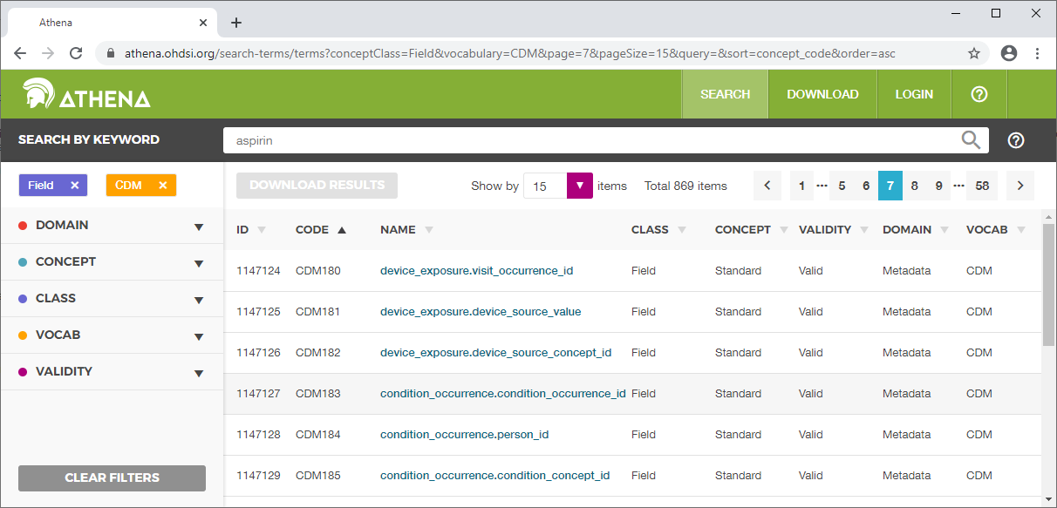

Slide 9
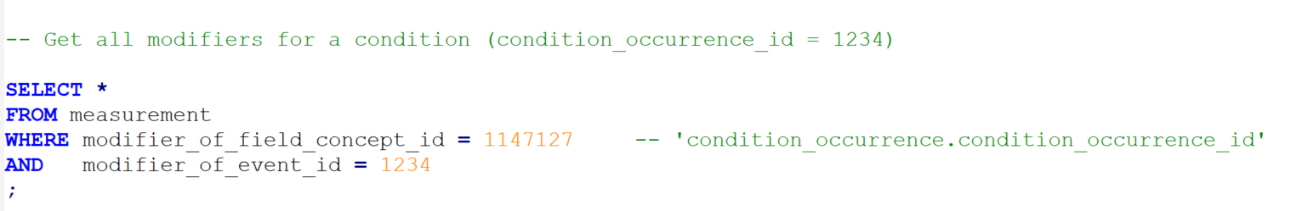
Get all modifiers of an event

Slide 10
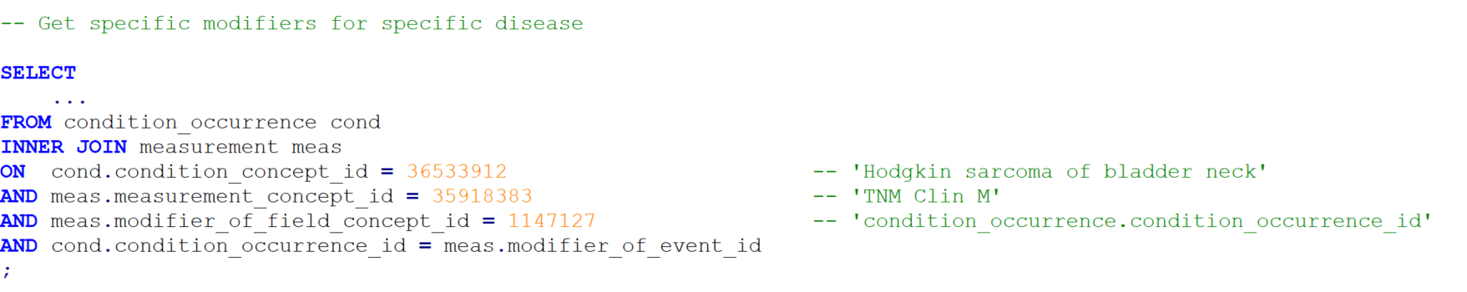
Get specific modifiers

Slide 11
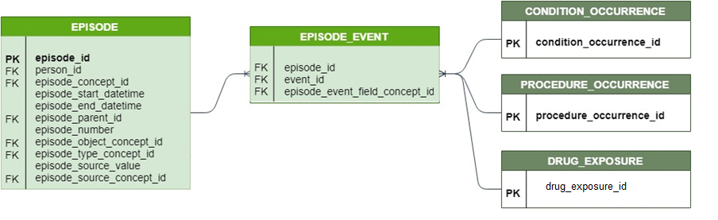
Episode_Event
Episodes and lower level events (e.g. conditions, drugs) can be linked via Episode_Event table
Similar relationship structure as modifier
event_id + field_concept_id
Modifier relationship is many-to-one (many modifiers for one condition)
Episode_Event allows many-to-many

Slide 12
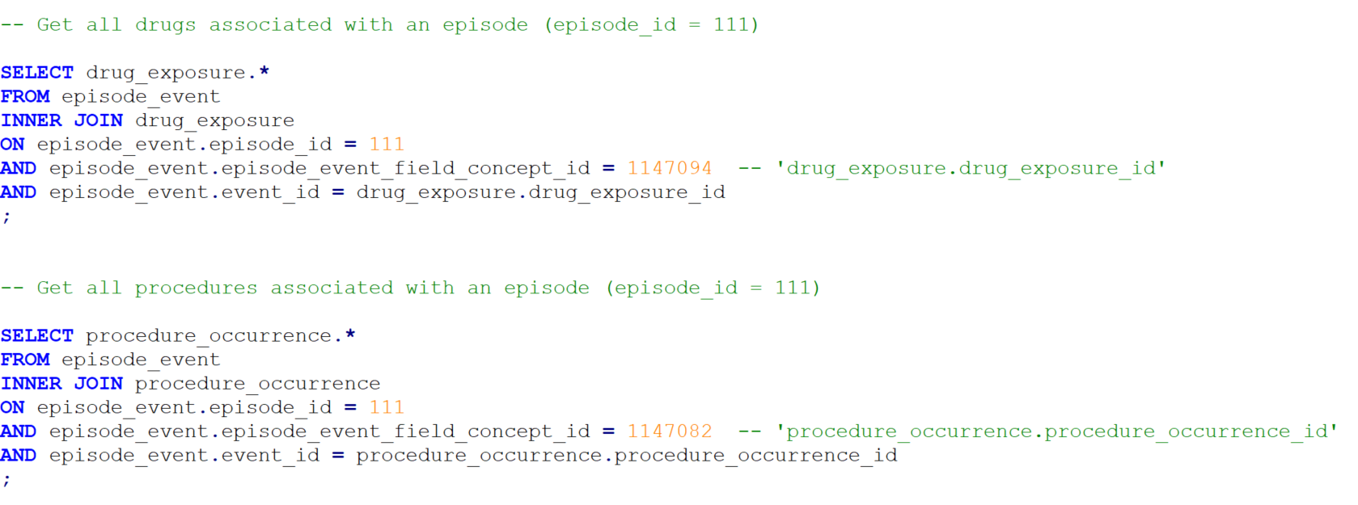
Episode_Event

Slide 13
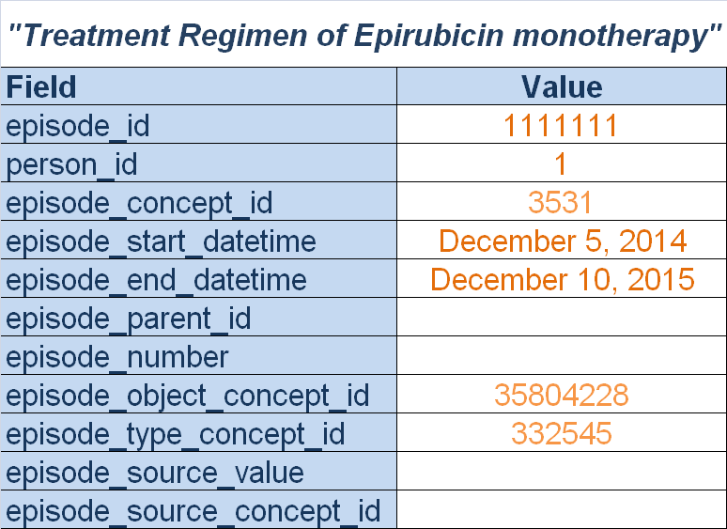
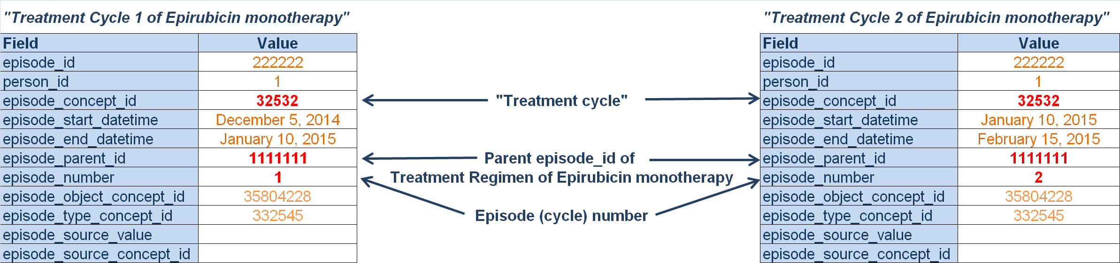
Nested Treatment Episodes

Slide 14
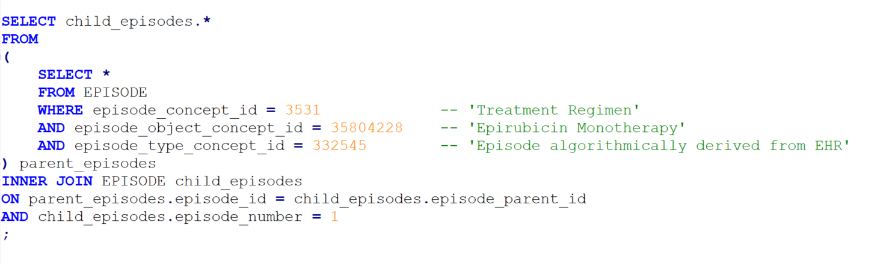
Episode
episode_id | Primary key
episode_concept_id | General episode type
episode_parent_id | FK to episode_id of parent episode
episode_number | Ordinal count within parent
episode_object_concept_id | What the episode describes
episode_type_concept_id | Provenance
Notes:
Get all treatment regimen episodes

Slide 15
Episode
episode_id | Primary key
episode_concept_id | General episode type
episode_parent_id | FK to episode_id of parent episode
episode_number | Ordinal count within parent
episode_object_concept_id | What the episode describes
episode_type_concept_id | Provenance
Notes:
Get a specific type of treatment regimen

Slide 16
Episode
episode_id | Primary key
episode_concept_id | General episode type
episode_parent_id | FK to episode_id of parent episode
episode_number | Ordinal count within parent
episode_object_concept_id | What the episode describes
episode_type_concept_id | Provenance
Notes:
Restrict episodes to only those that were derived algorithmically

Slide 17
Episode
episode_id | Primary key
episode_concept_id | General episode type
episode_parent_id | FK to episode_id of parent episode
episode_number | Ordinal count within parent
episode_object_concept_id | What the episode describes
episode_type_concept_id | Provenance
Notes:
Find the treatment cycle episodes within these treatment regimen episodes

Slide 18
Episode
episode_id | Primary key
episode_concept_id | General episode type
episode_parent_id | FK to episode_id of parent episode
episode_number | Ordinal count within parent
episode_object_concept_id | What the episode describes
episode_type_concept_id | Provenance
Notes:
Limit episodes to only the first cycle in this regimen

Slide 19
Episode
episode_id | Primary key
episode_concept_id | General episode type
episode_parent_id | FK to episode_id of parent episode
episode_number | Ordinal count within parent
episode_object_concept_id | What the episode describes
episode_type_concept_id | Provenance

Slide 20
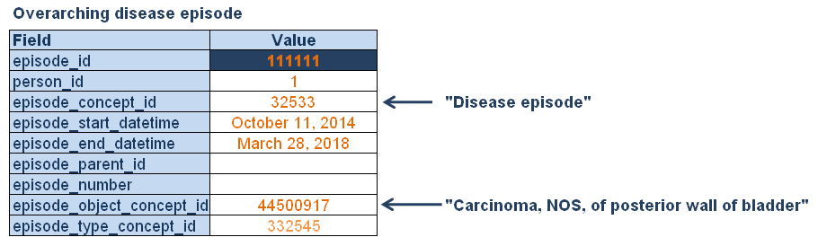
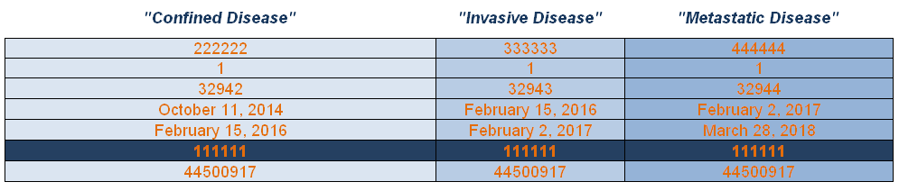
Nested Disease Episode

Slide 21
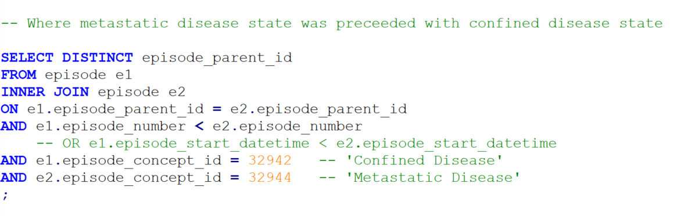
Nested Disease Episode

Slide 22
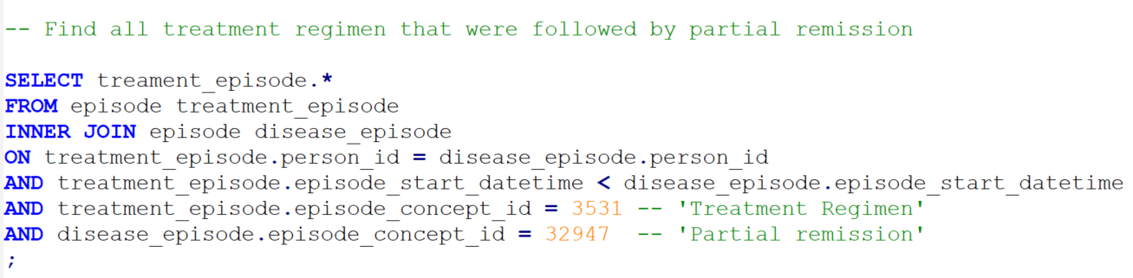
Disease vs. Treatment Episodes
Treatment episodes do not currently roll up to the overarching disease episode
Consequently, when comparing disease to treatment episodes we cannot use the episode_parent_id

Slide 23
Up next: SQL Exercises
We will put into practice what we have learned so far. A cheat sheet with relevant concepts will be provided.
Thanks for watching

